Slide 1
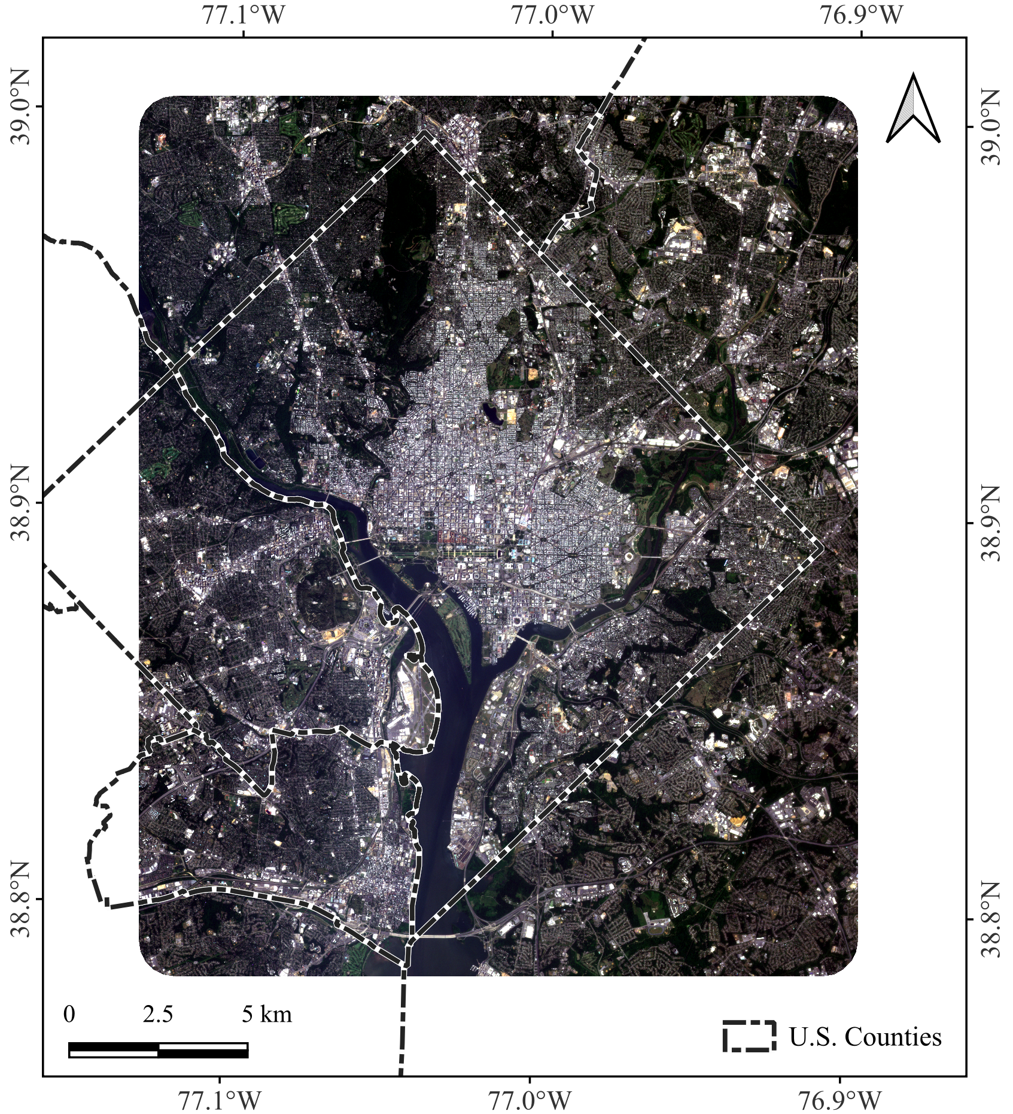
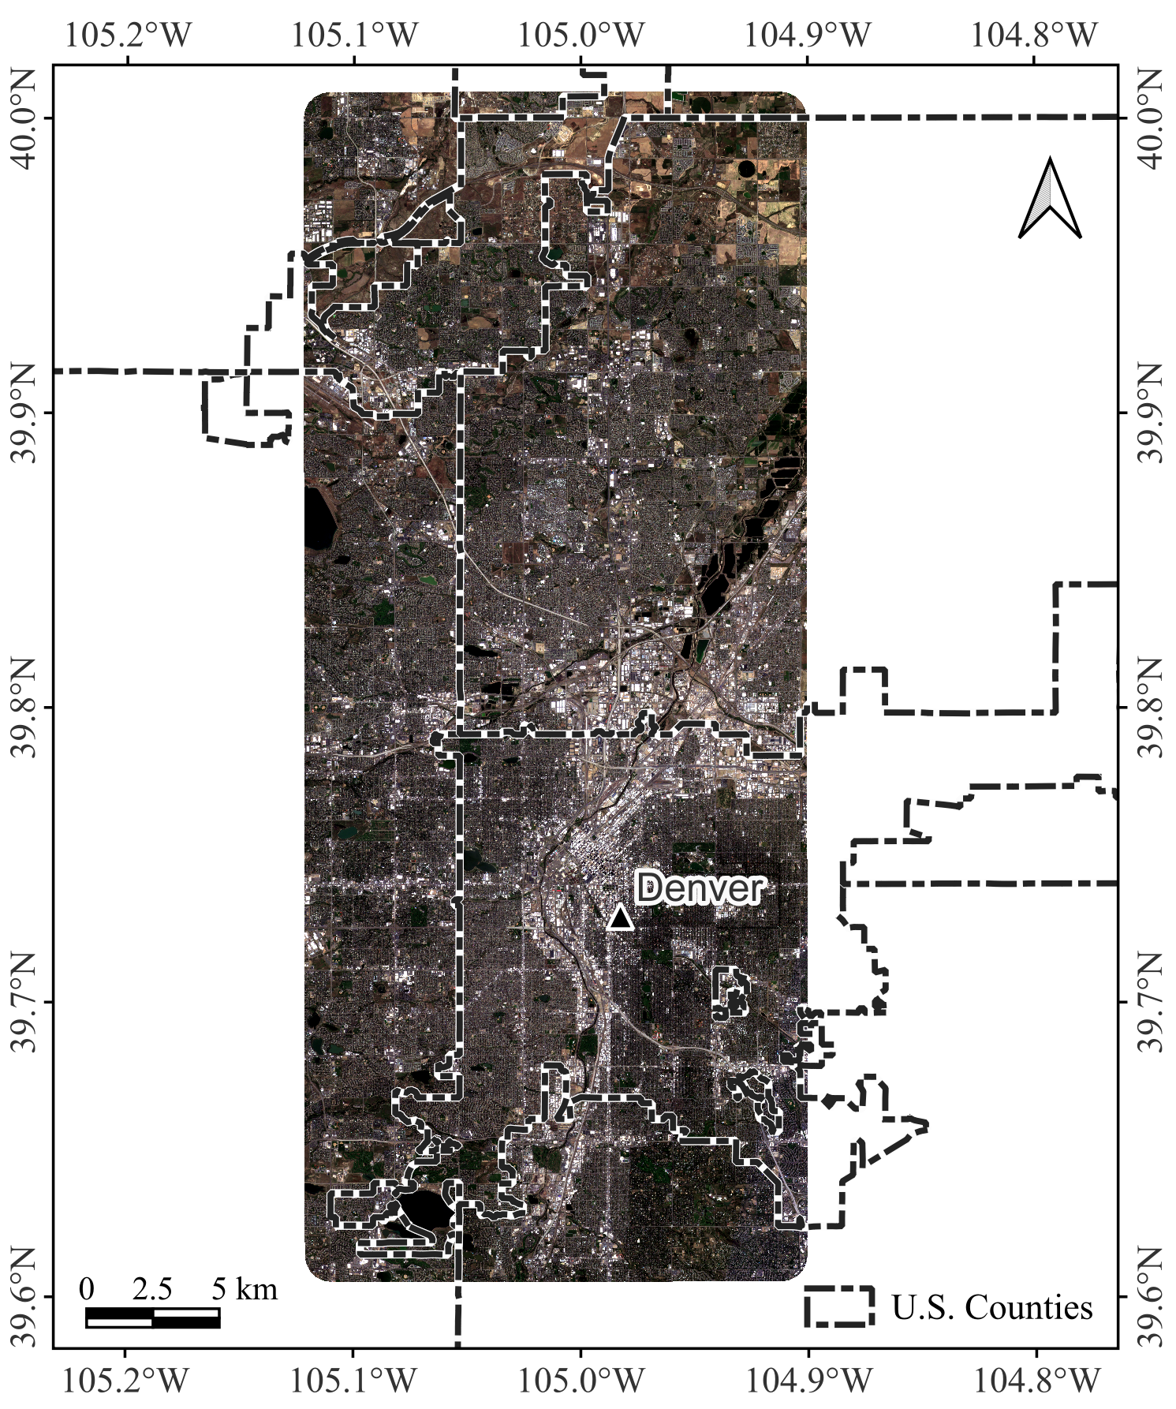
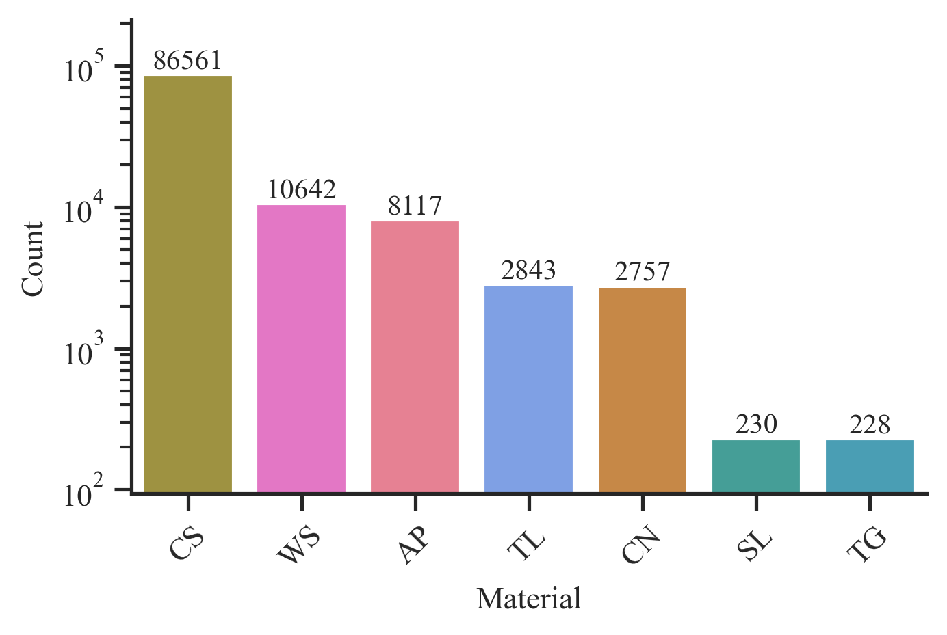
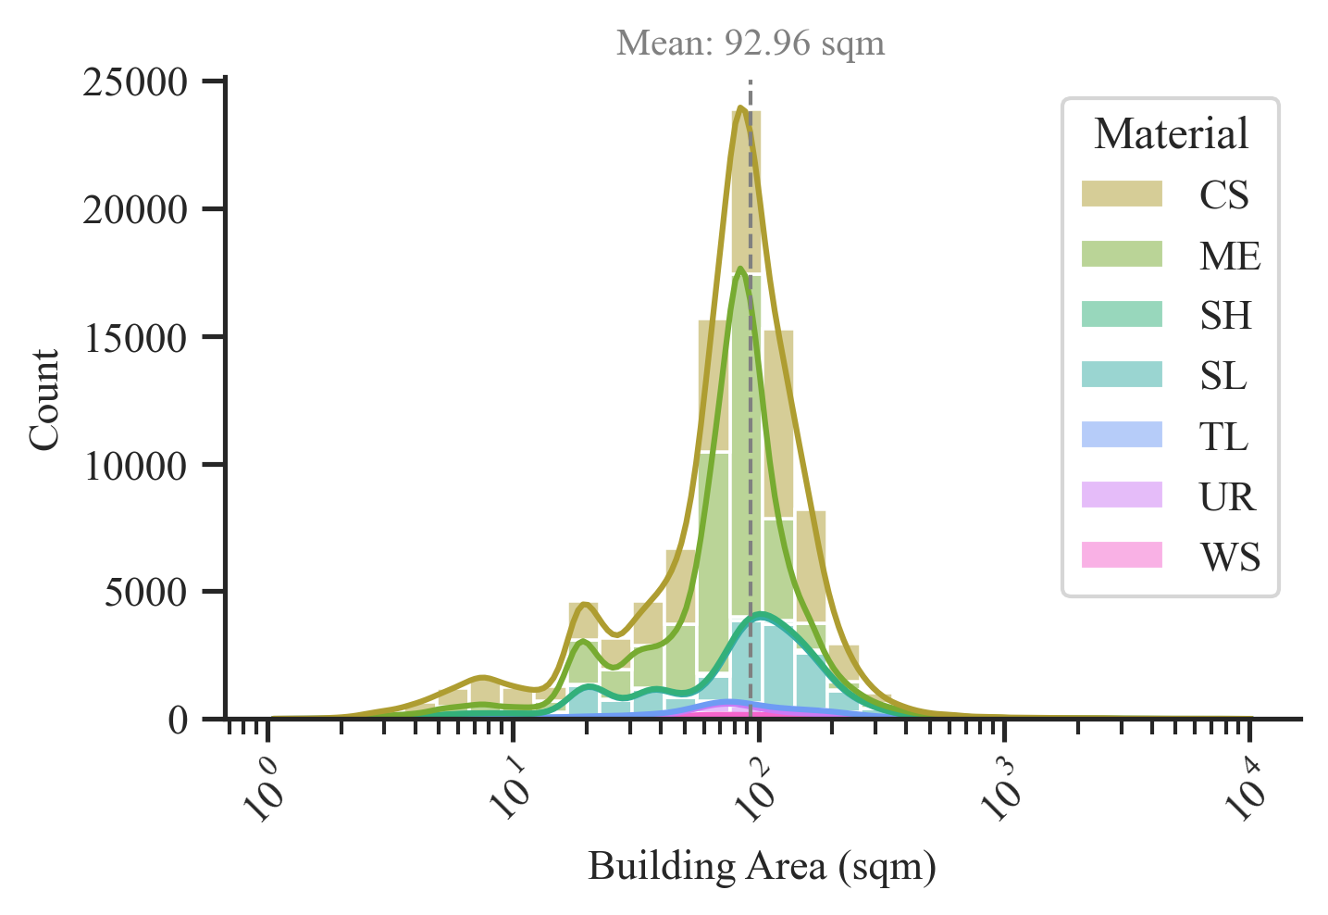
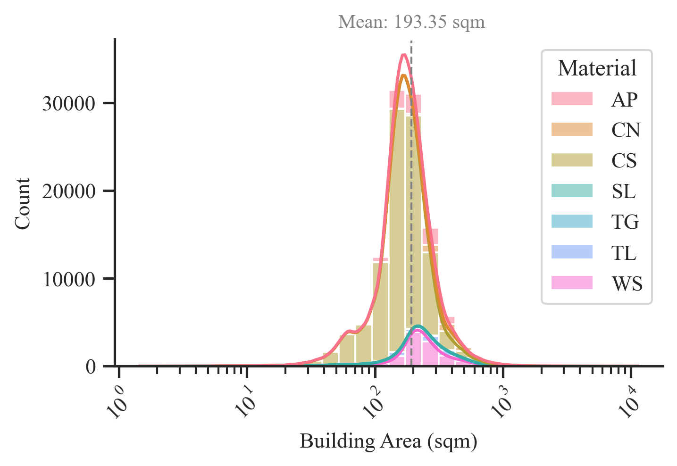
(a)
(b)
(c)
(d)
(e)
(f)
Figure 1. Study area map with (a-b) Planet PSB.SD true-color (Red-Green-Blue) composites, (c-d) log-scaled distribution of roof material classes and (e-f) log-scaled distribution of building indoor areas. AP=Asphalt; CN=Concrete; CS=Composition Shingle; ME=Metal; SH=Shingle; SL=Slate; TL=Tile; TG=Tar and Gravel; UR=Urethane; WS=Wood Shake/shingle.

Slide 2
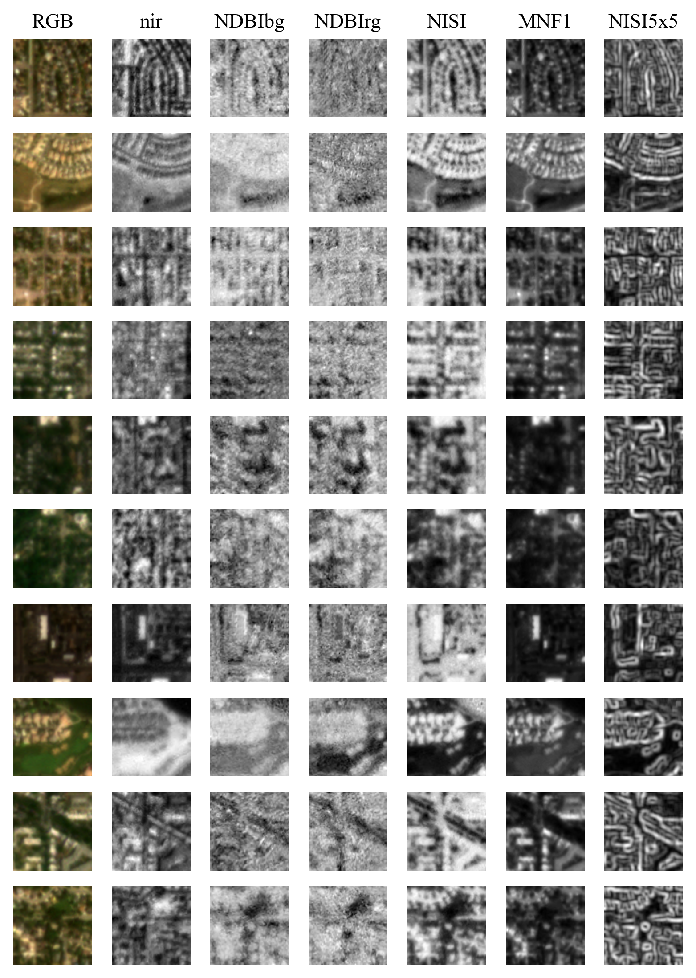
AP
CN
CS
ME
SH
SL
TG
TL
UR
WS
Figure 2. Example image chunks with 78x78 dimensions for roof material classes in both D.C. and Denver with RGB true-color and bands used in classification models from the PSB.SD. If a class exists in both regions, the region with the larger sample size for that class was used to select a random labeled image chunk. AP=Asphalt; CN=Concrete; CS=Composition Shingle; ME=Metal; SH=Shingle; SL=Slate; TL=Tile; TG=Tar and Gravel; UR=Urethane; WS=Wood Shake/shingle.

Slide 3
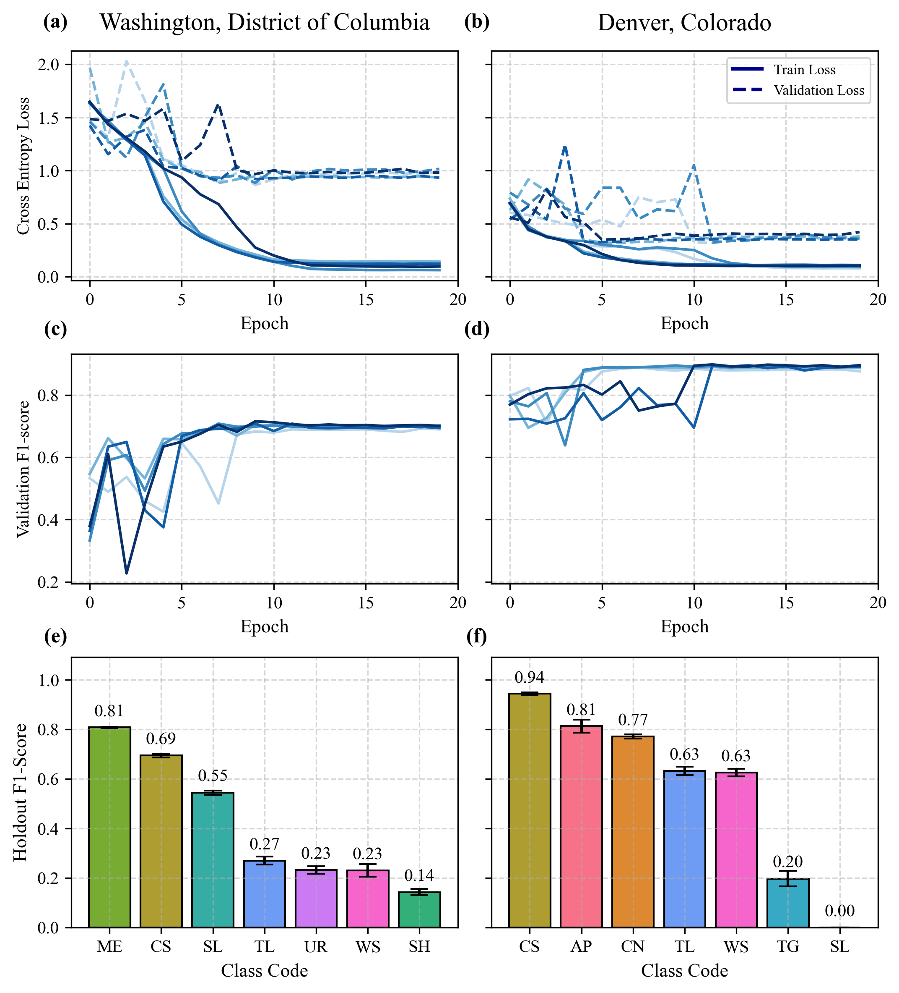
Figure 3. Results from 5-fold cross-validation ResNet-18 model. (a, b) Model Cross Entropy Loss functions for training (-) and validation (--) across epochs and folds; (c, d) Validation weighted F1-score across epochs and folds; (e, f) Holdout weighted F1-score across folds for each roof material class. AP=Asphalt; CN=Concrete; CS=Composition Shingle; ME=Metal; SH=Shingle; SL=Slate; TL=Tile; TG=Tar and Gravel; UR=Urethane; WS=Wood Shake/shingle.

Slide 4
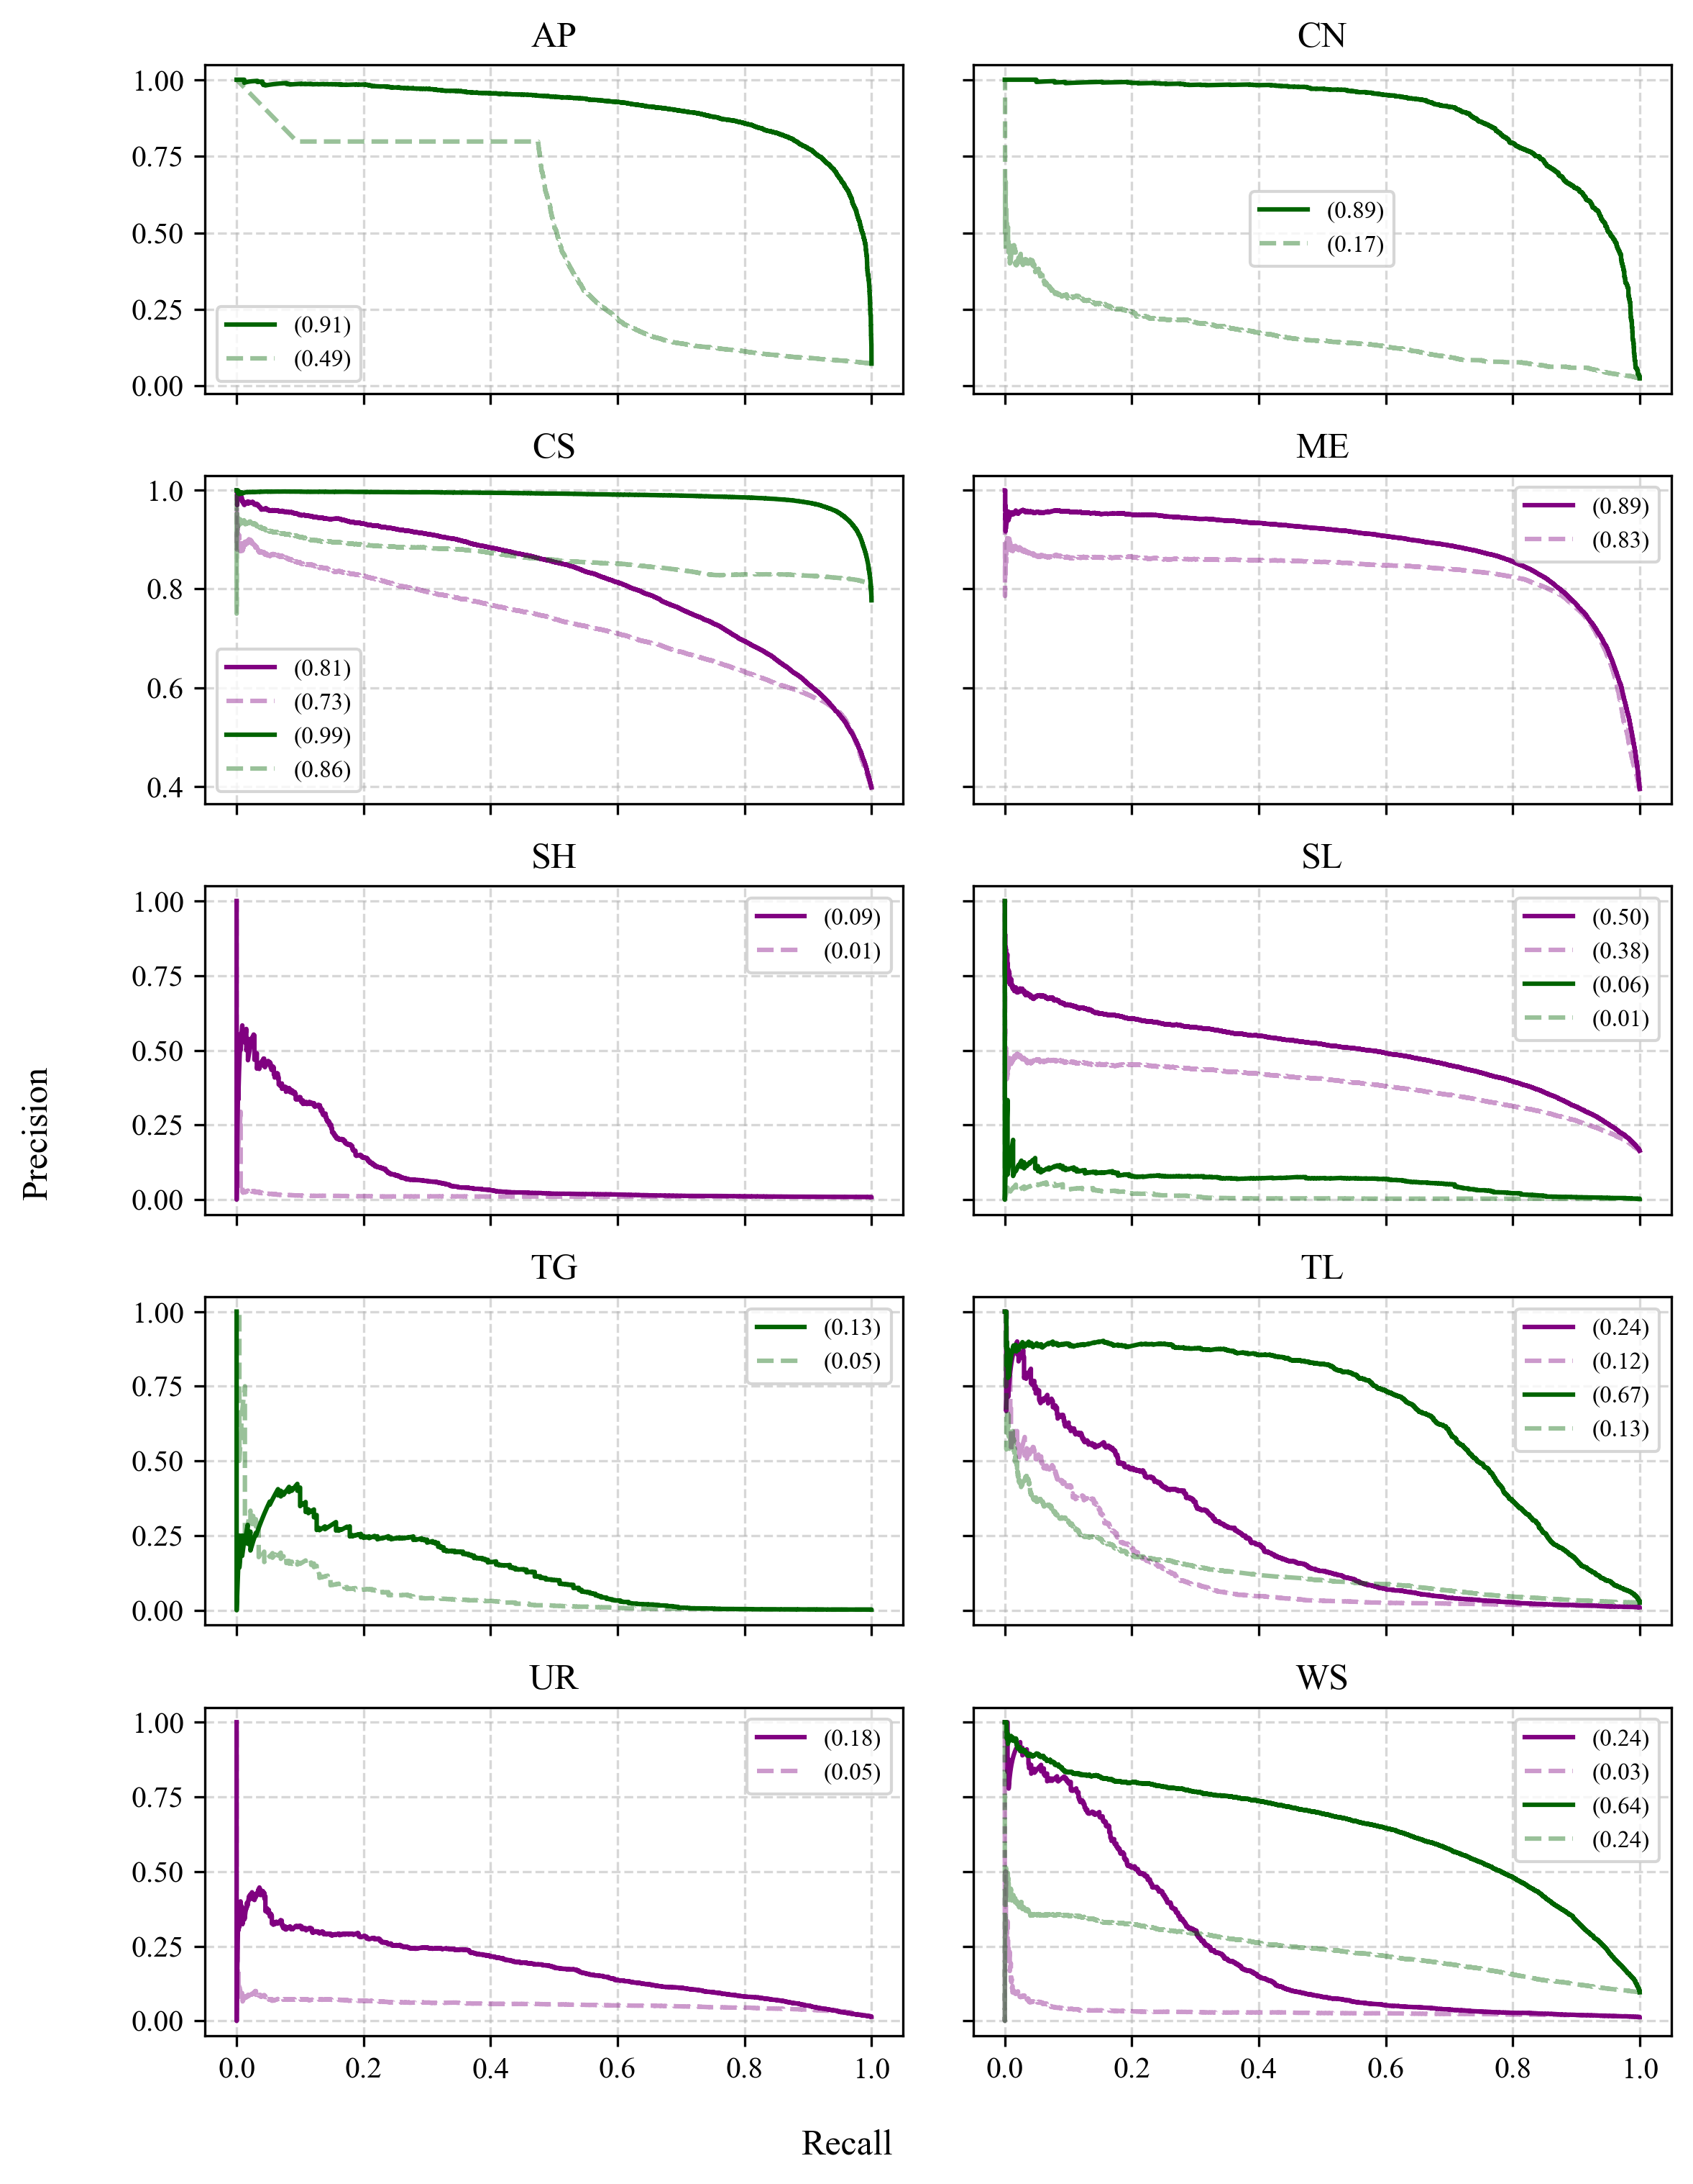

Slide 5
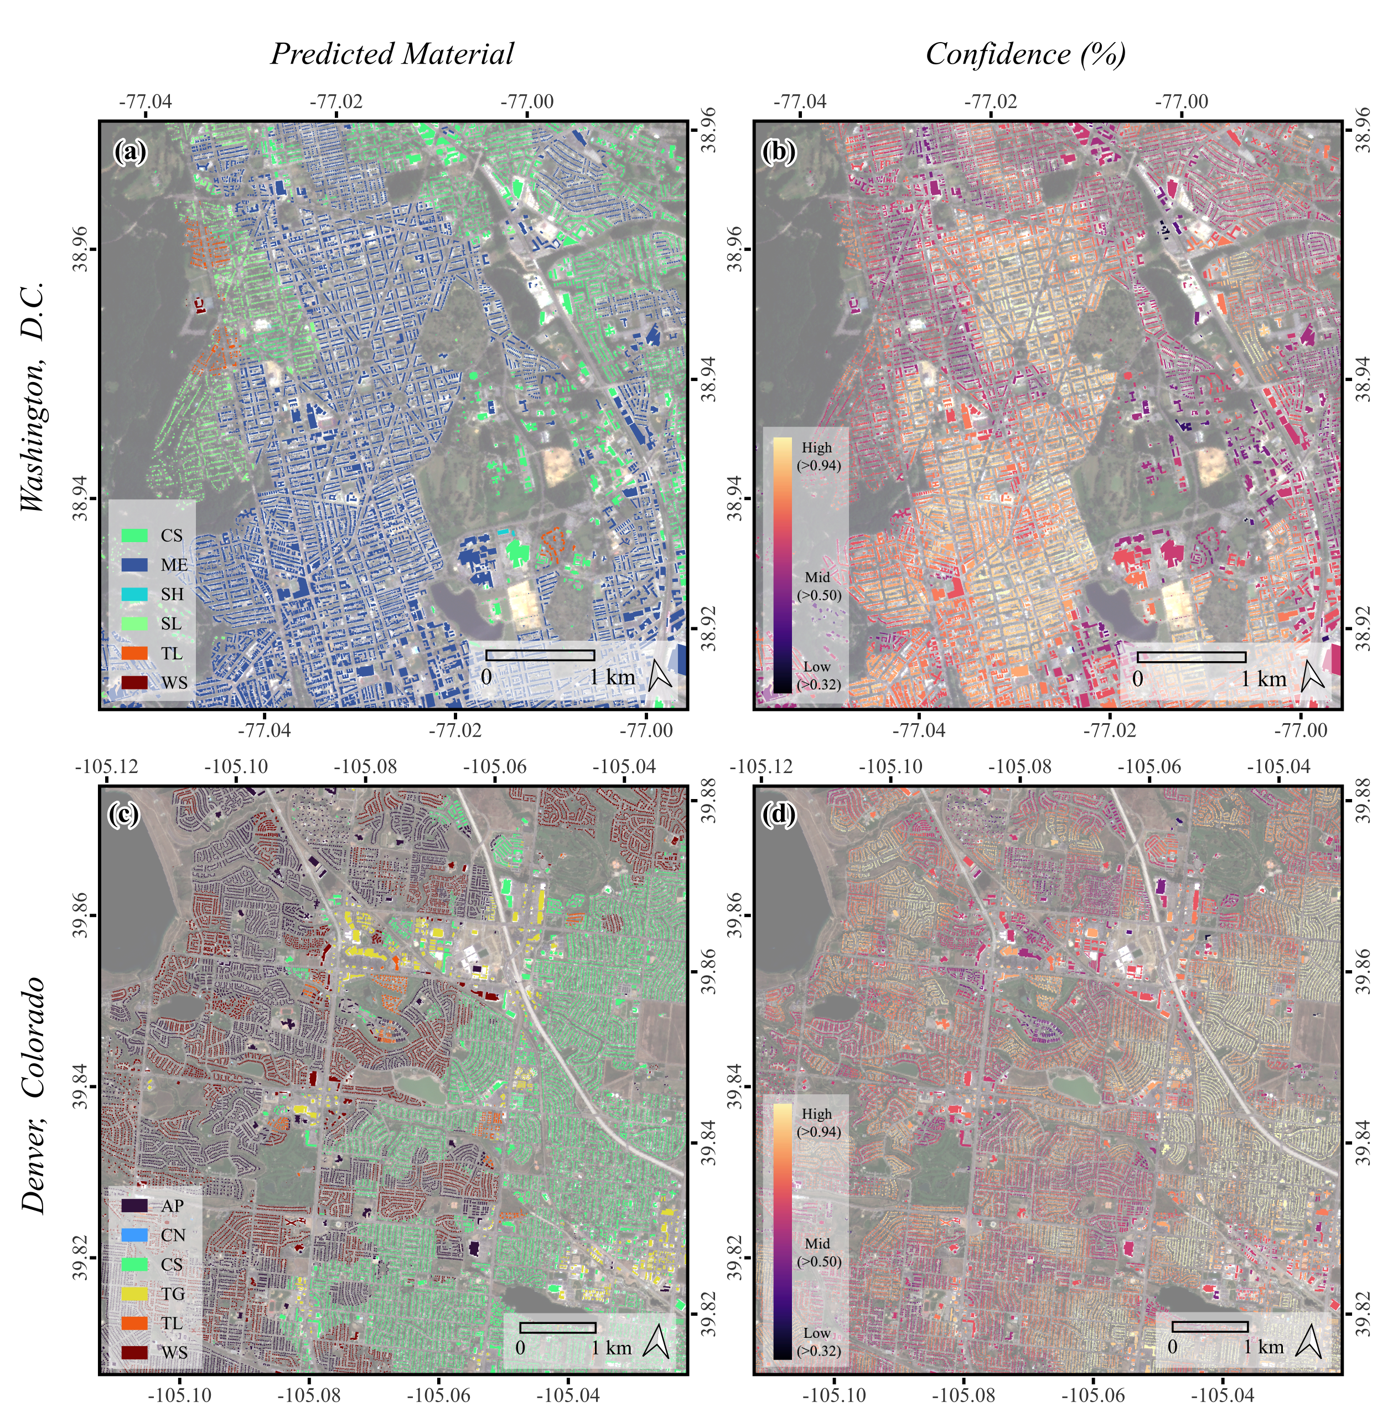

High
(>0.94)
Mid
(>0.50)
Low
(>0.32)

Slide 6
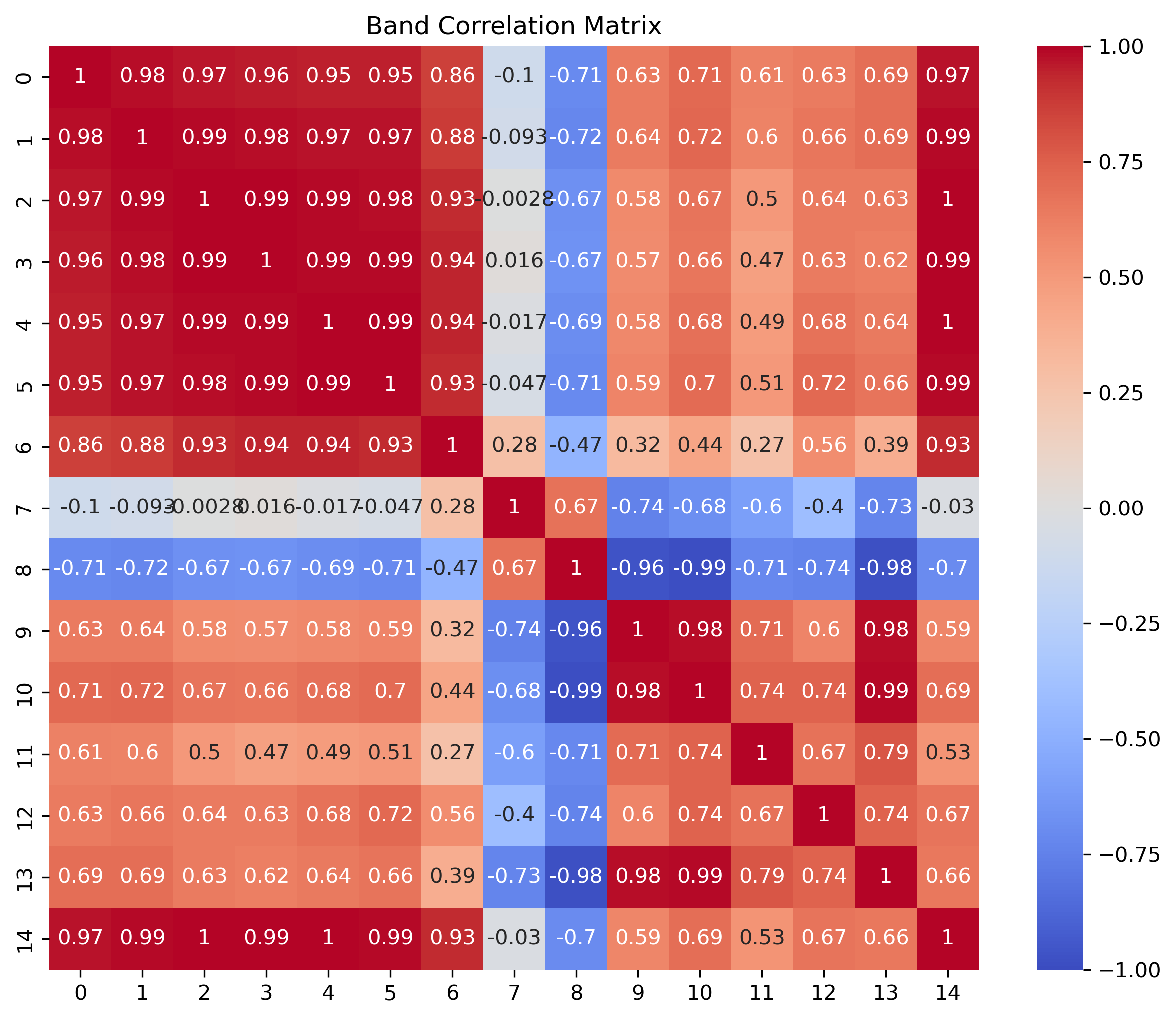
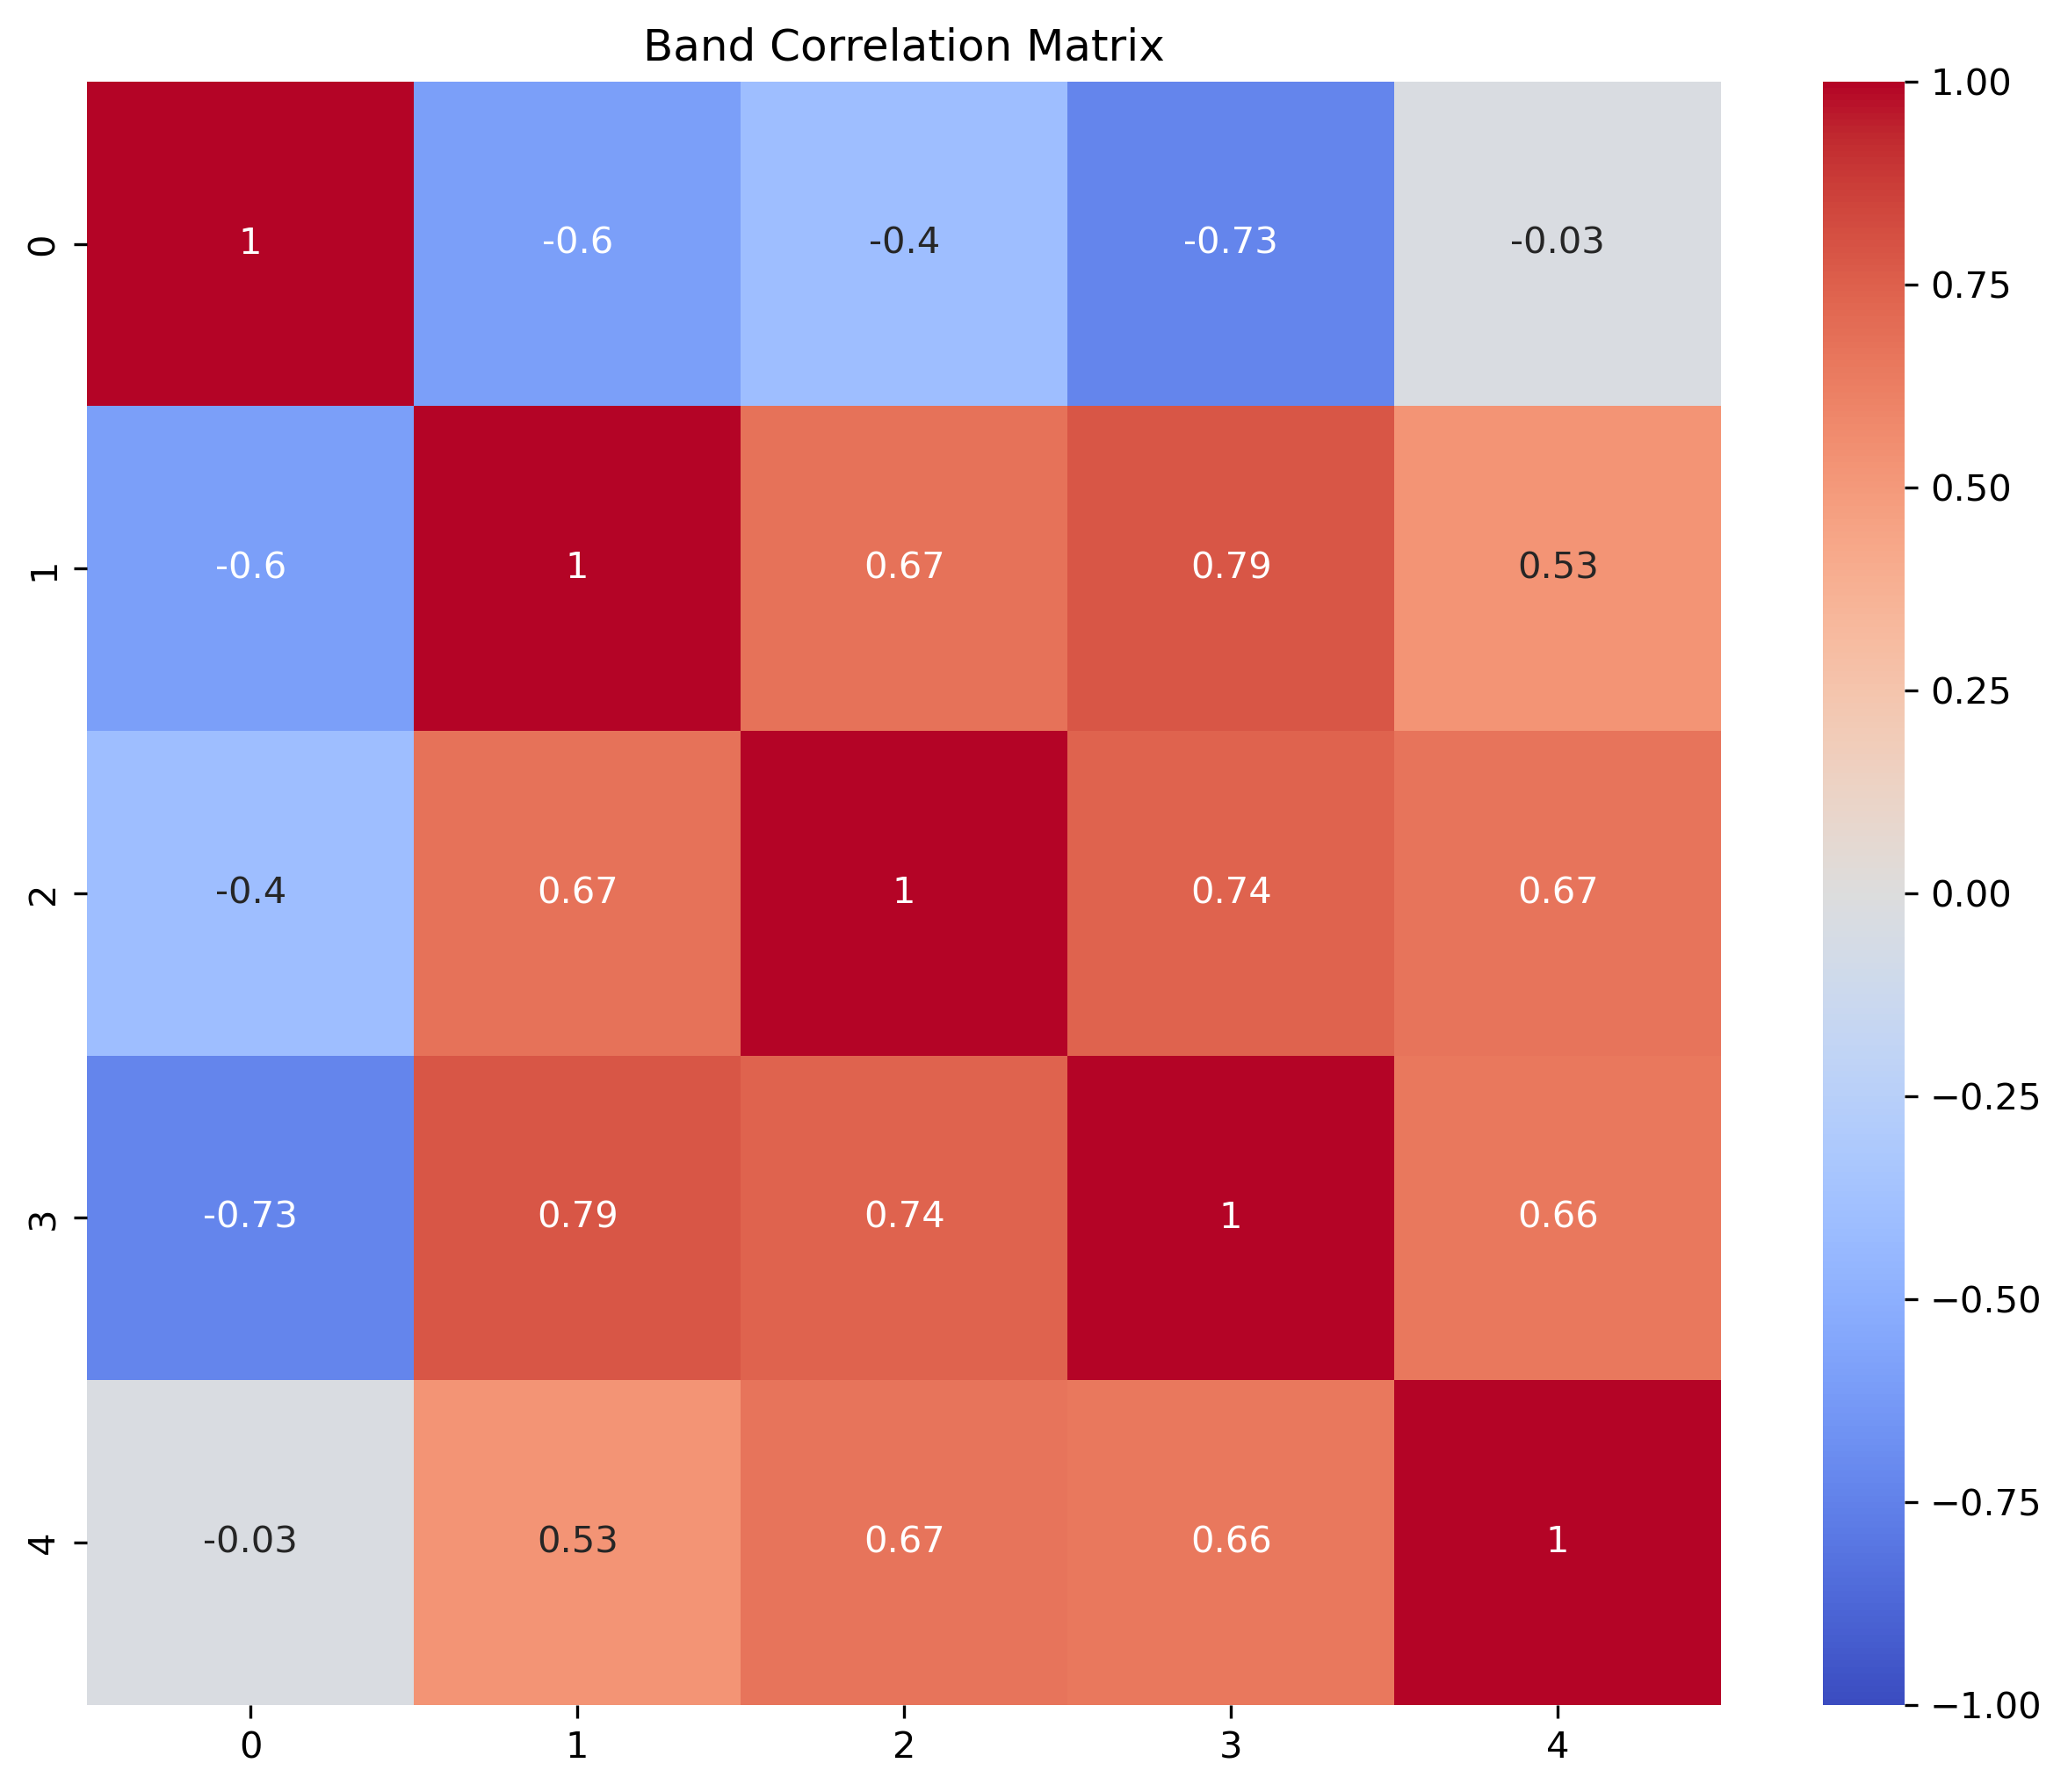
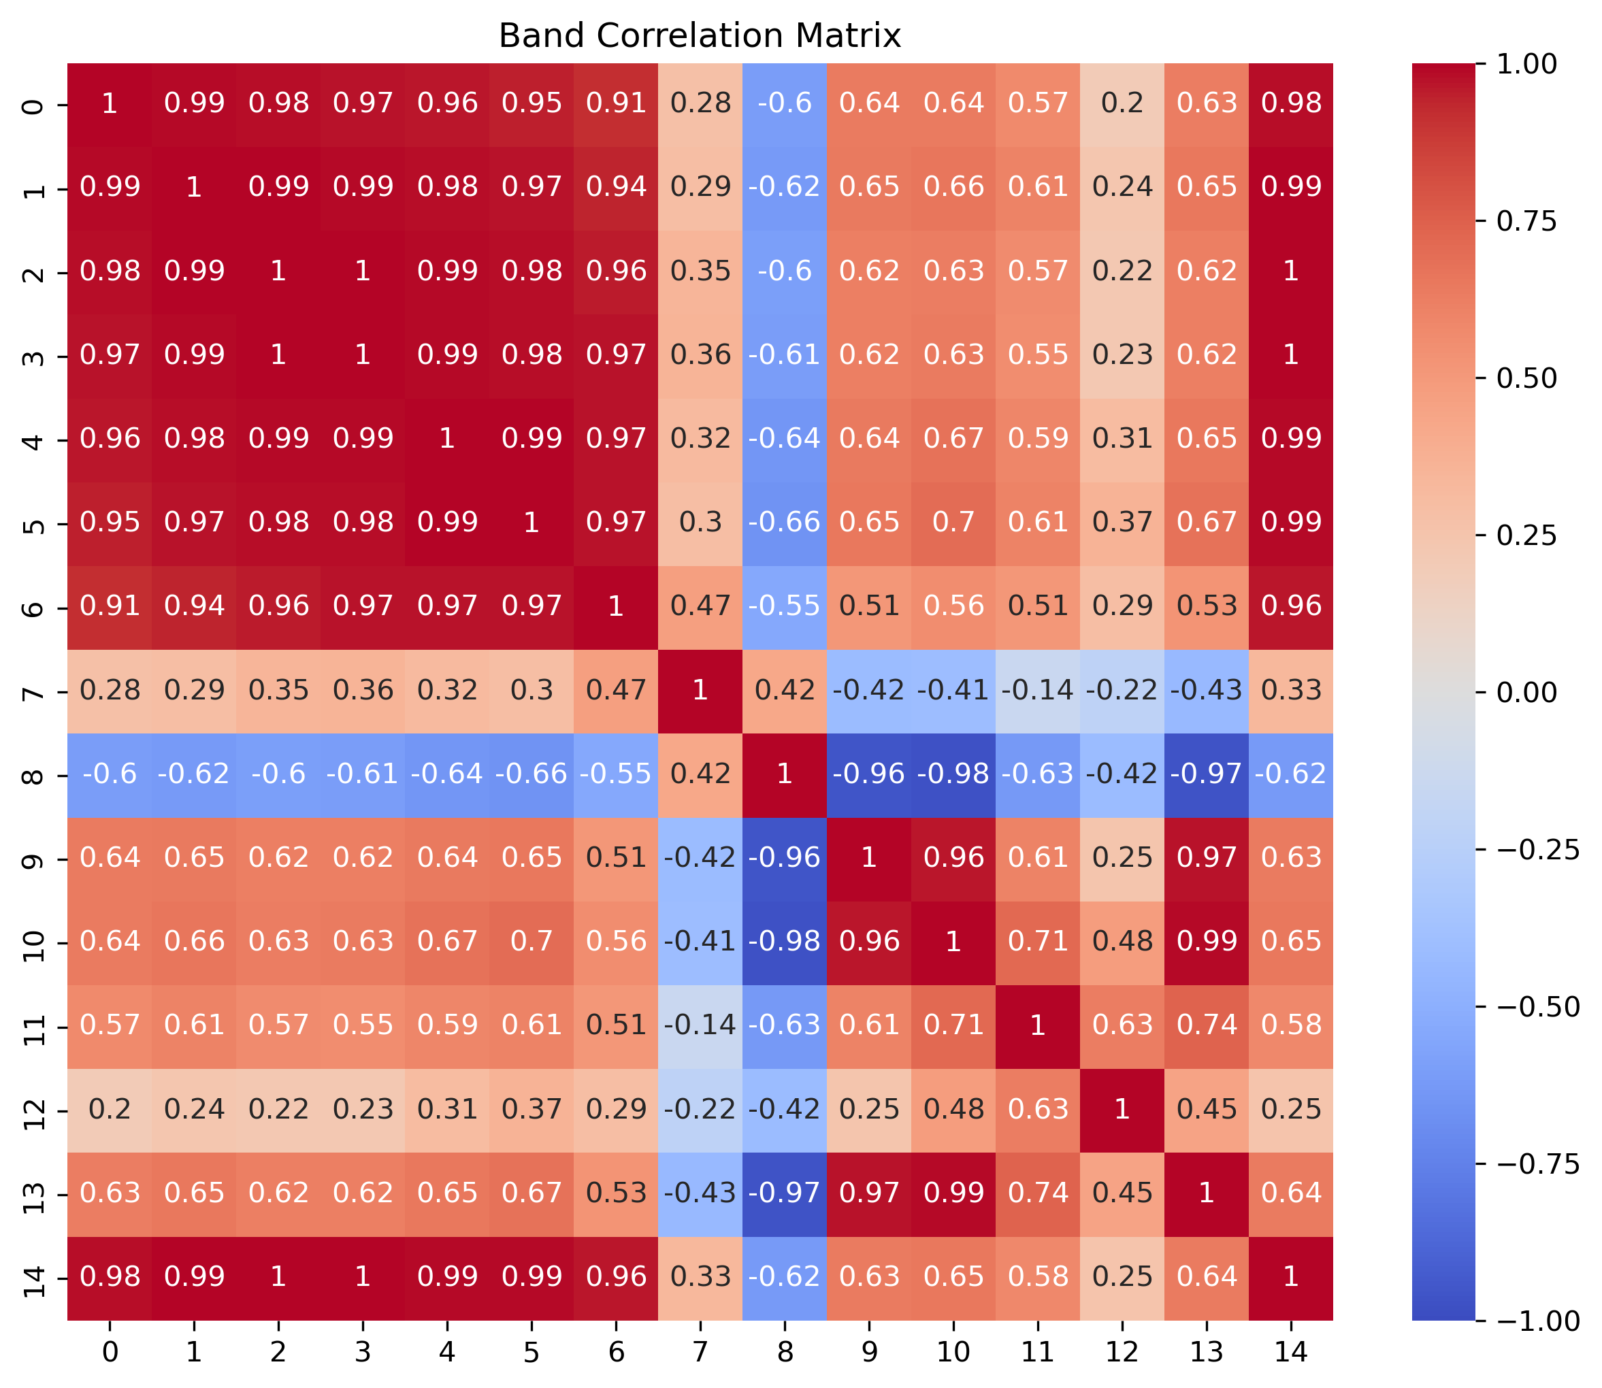
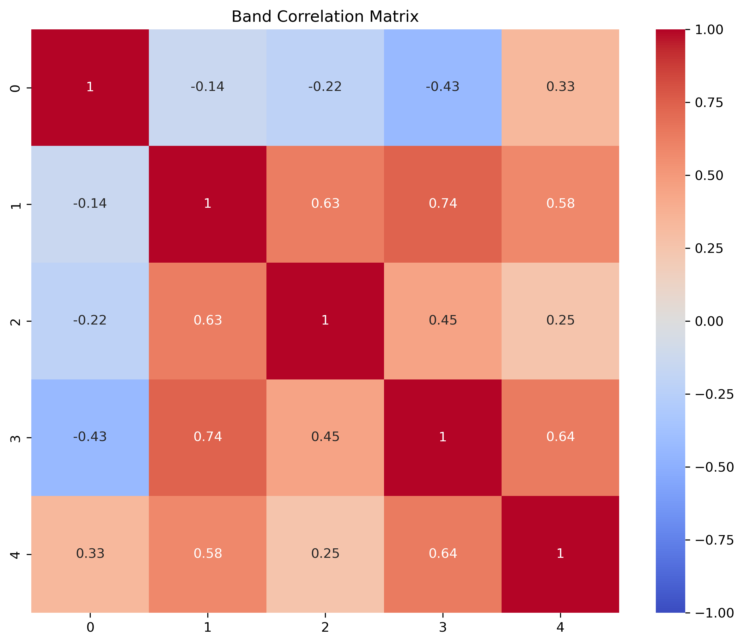
Figure SX
(a)
(b)
Washington, D.C.
(c)
(d)
Denver, Colorado

Slide 7
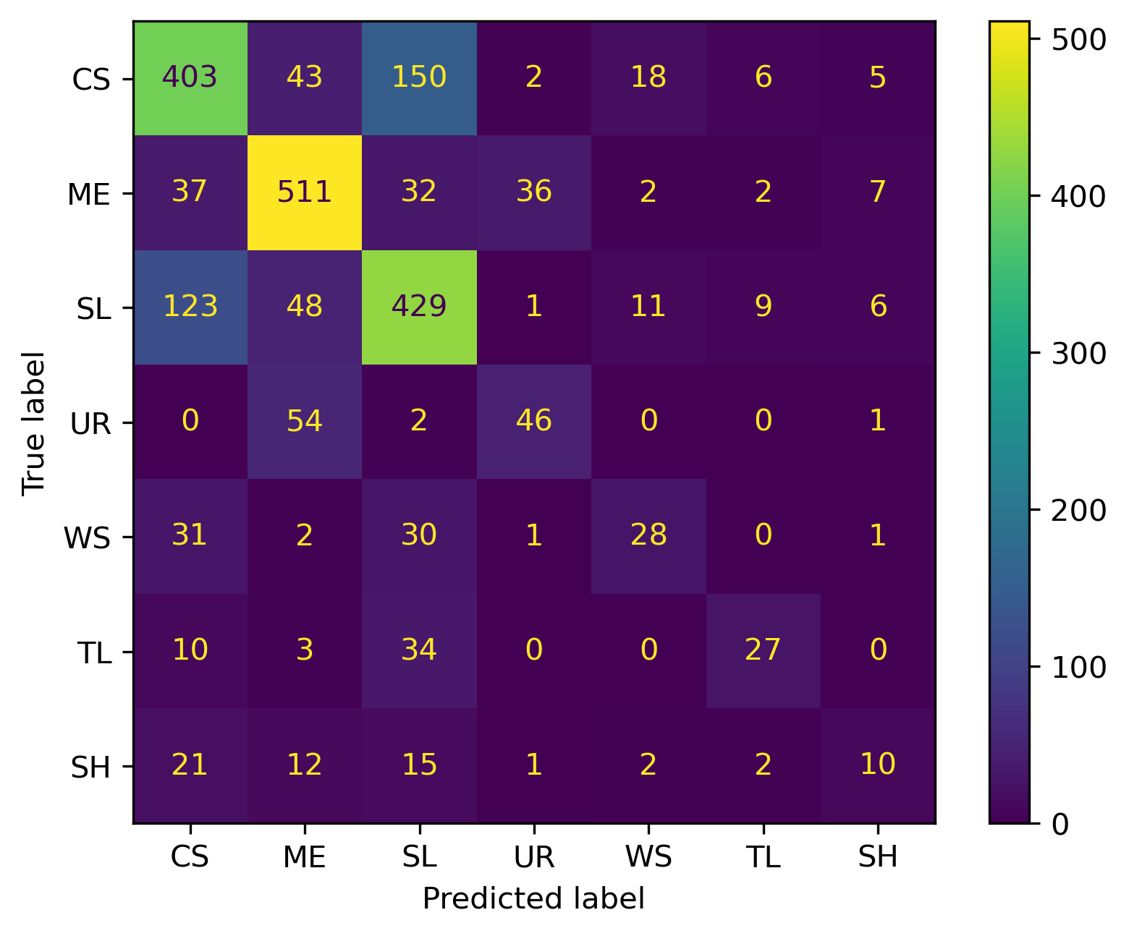
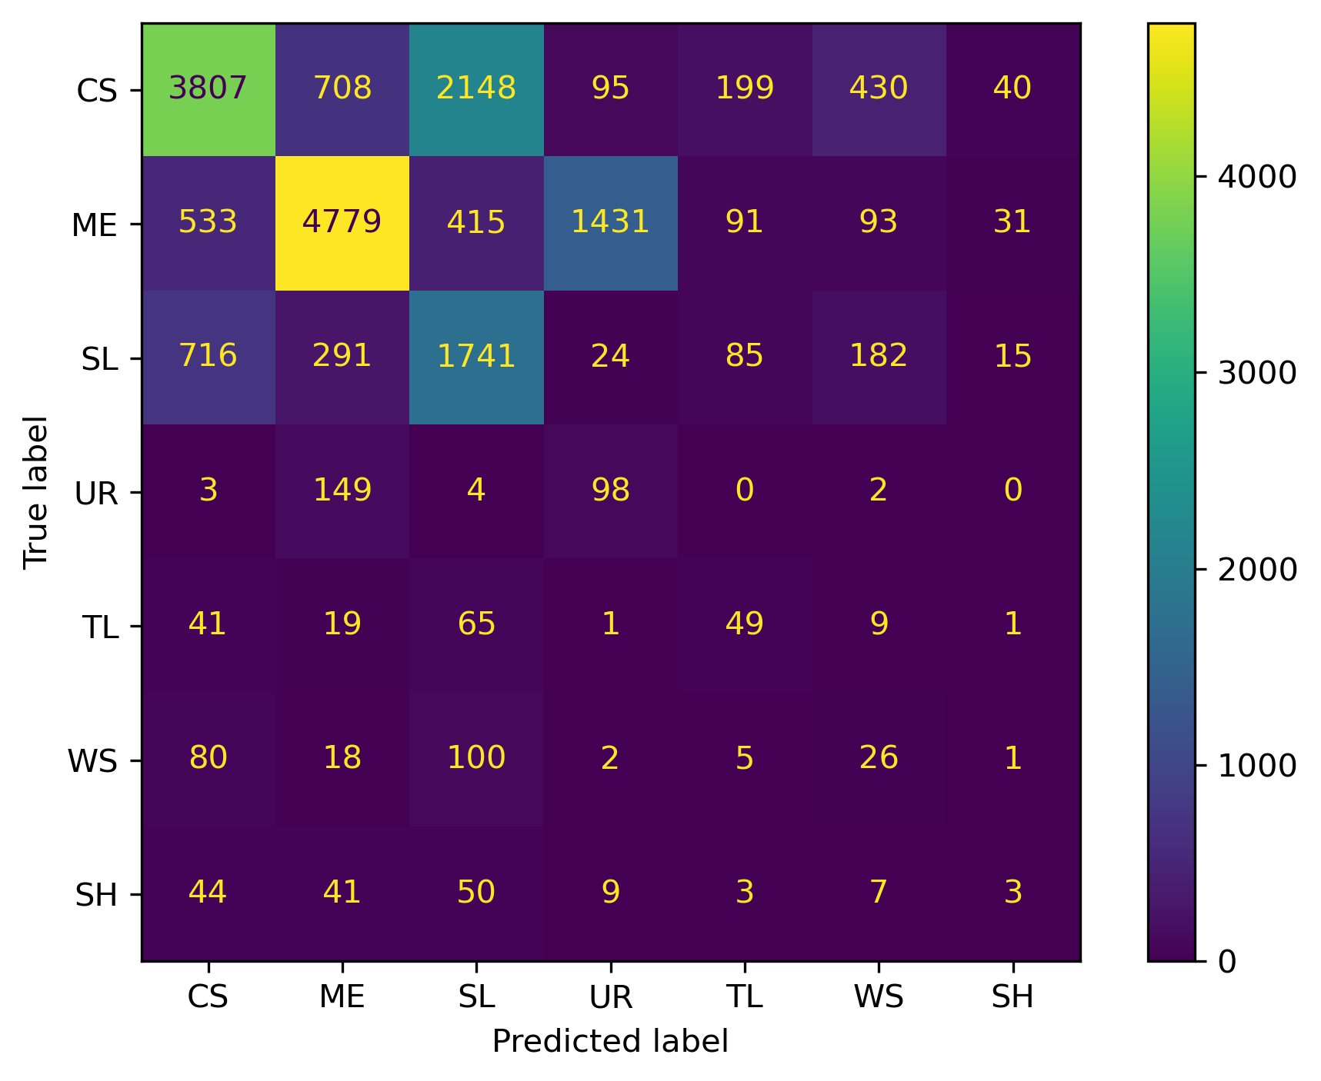
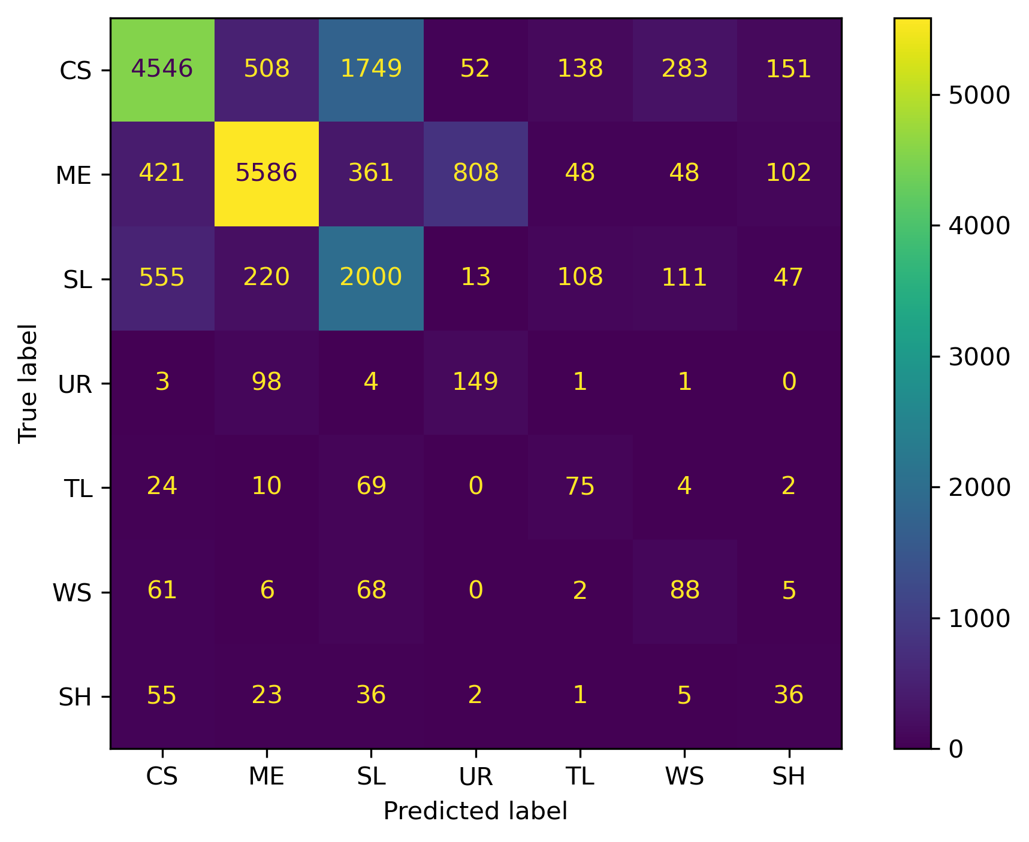
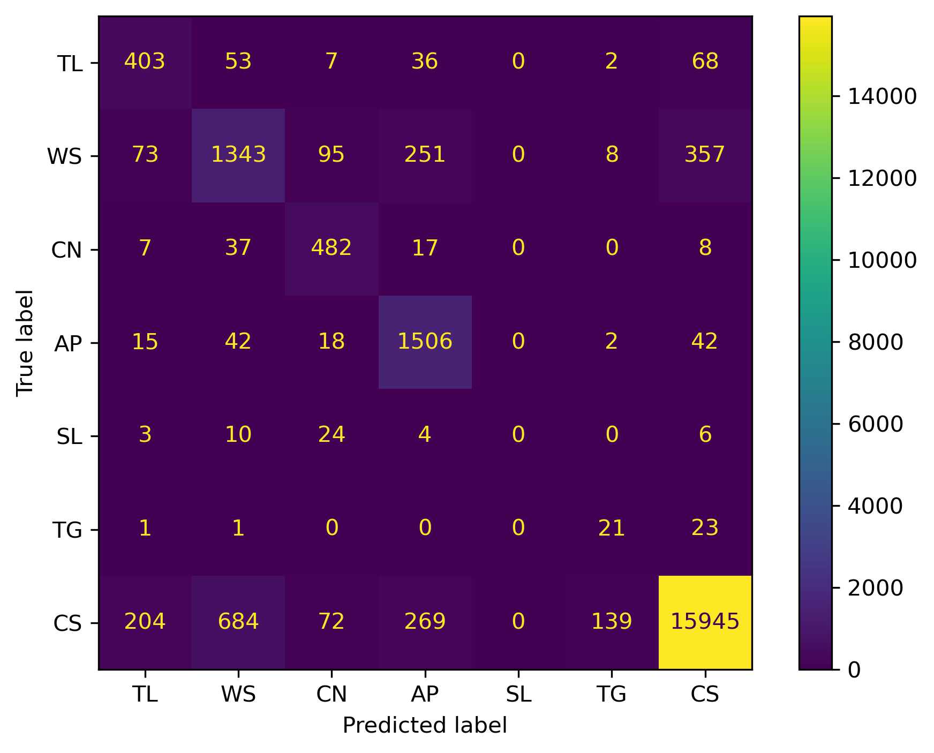
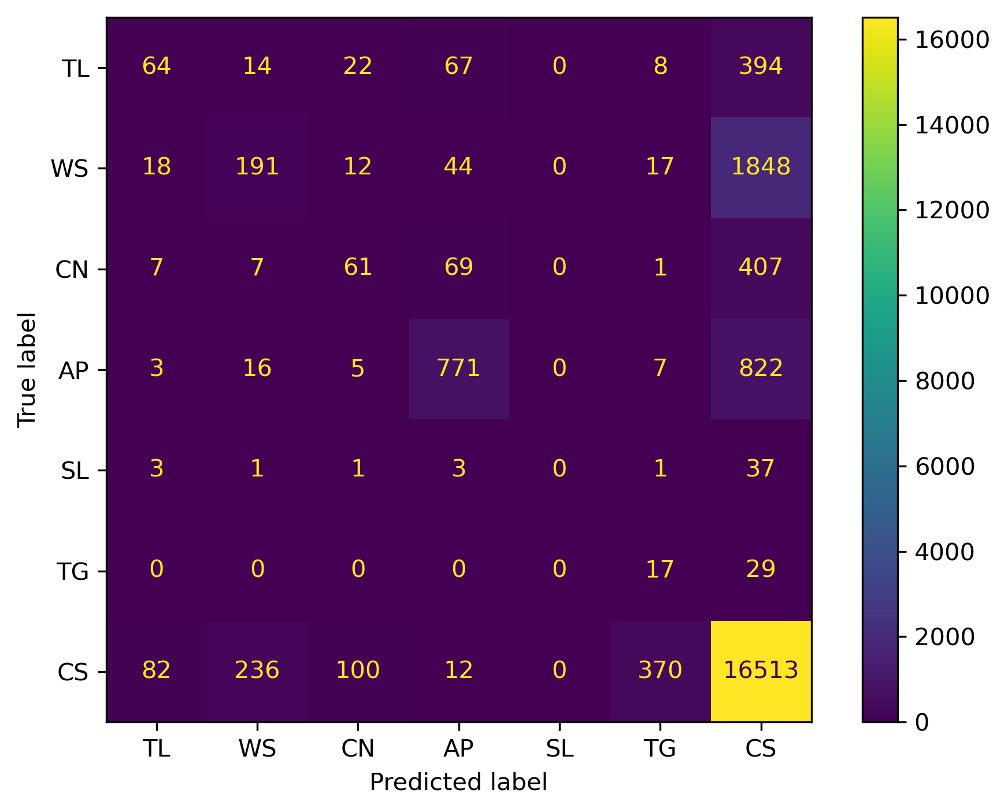
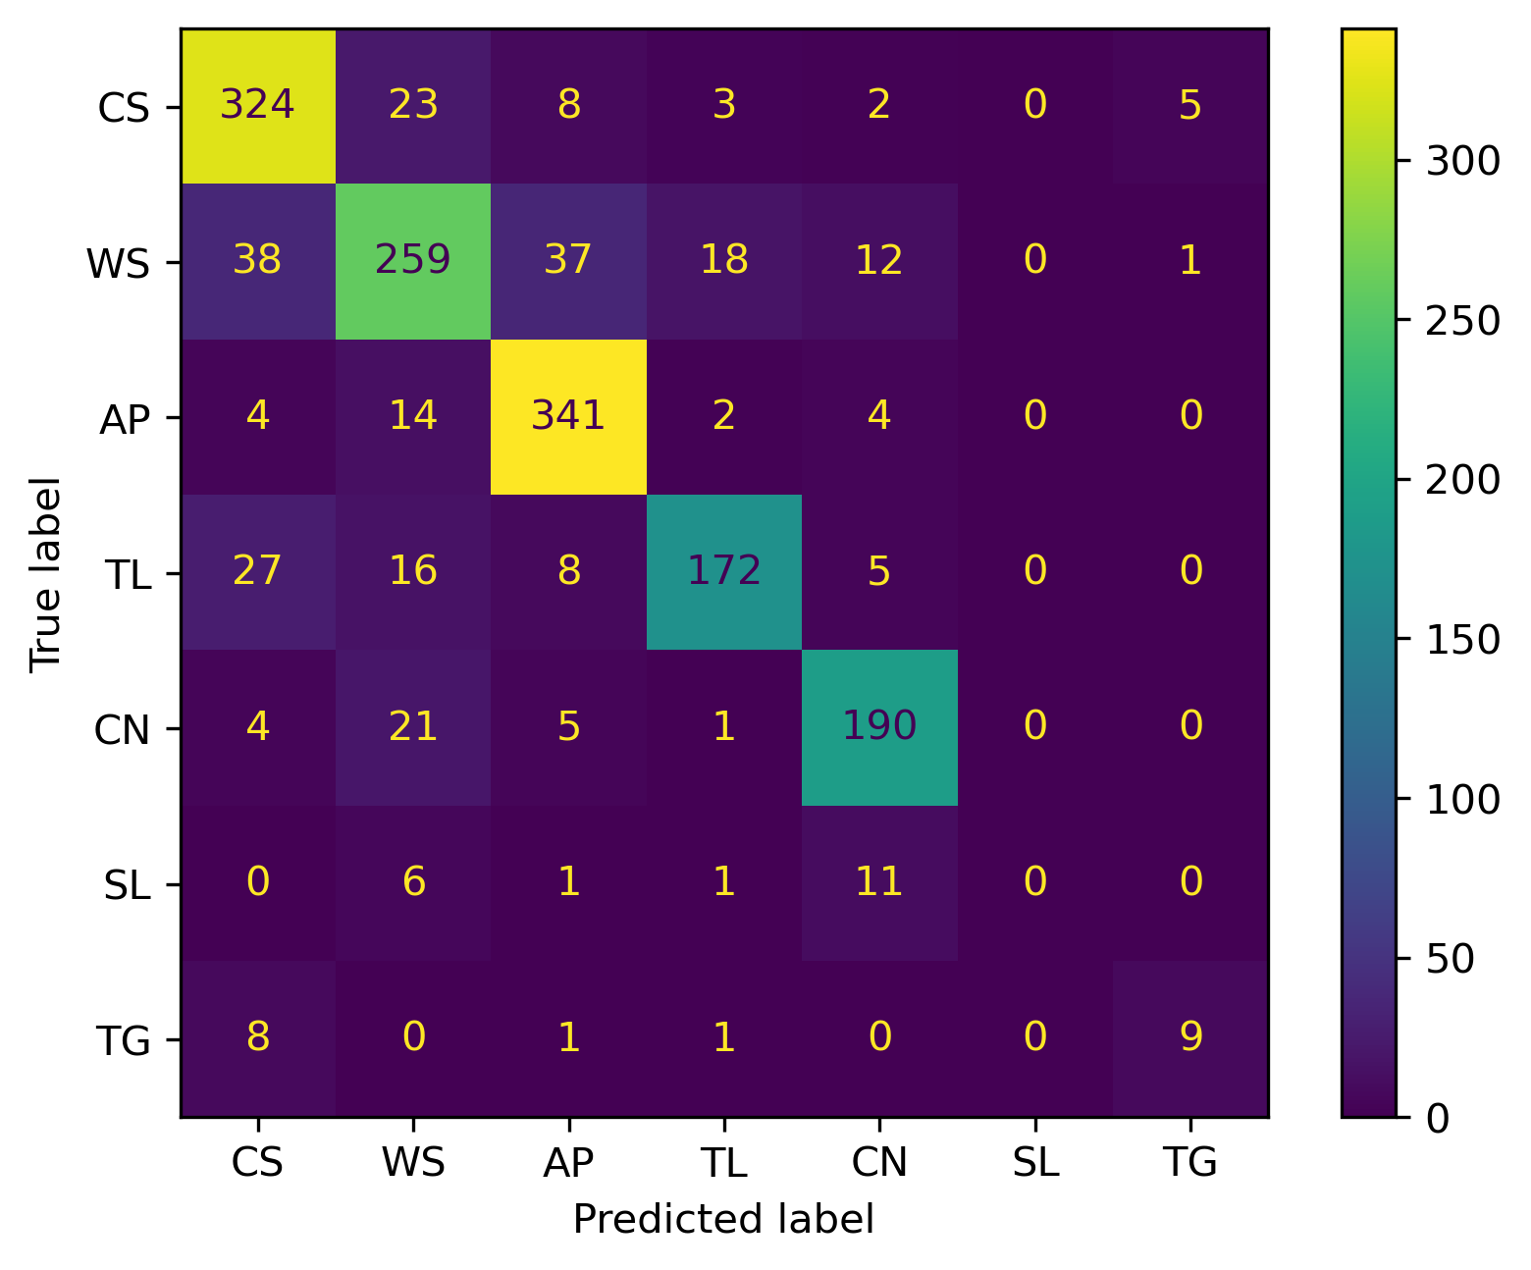
Figure SX
Resnet-18
XGBoost
Washington, D.C.
Denver, Colorado

Slide 8
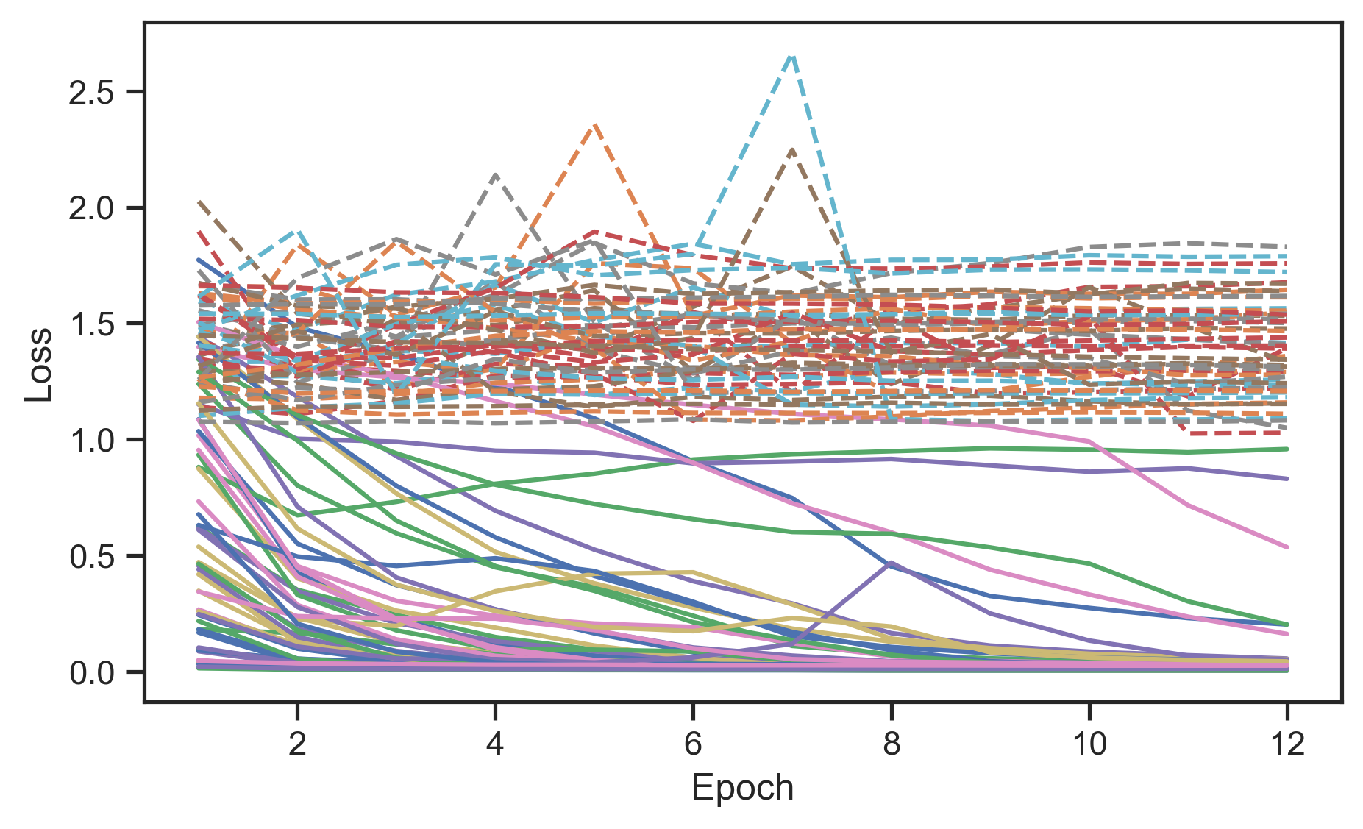
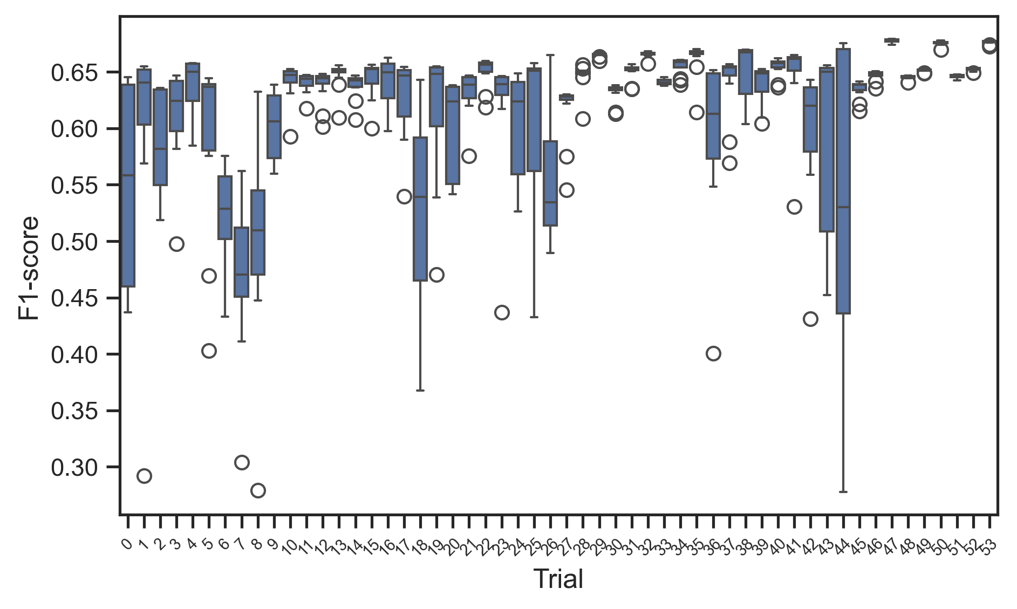
Figure SX
(a)
(b)

